Slide 1
Citing Poetry
MLA Format

Slide 2
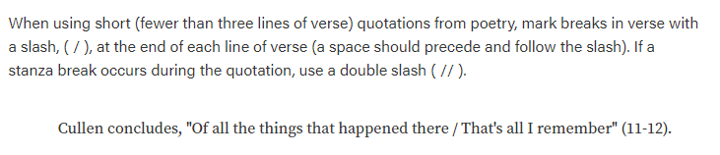
Citing Poetry (Three or Fewer Lines)

Slide 3
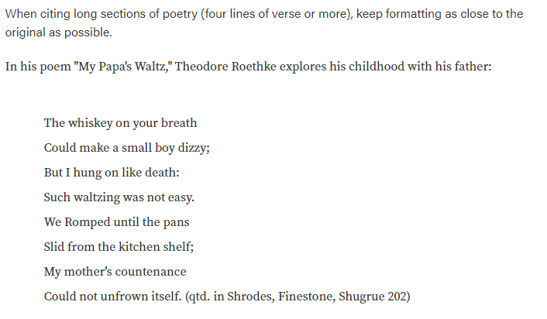
Citing Poetry (Four or More Lines)

Slide 4
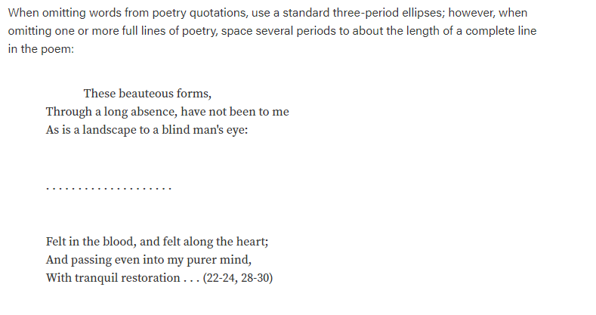
Omitting Lines

Slide 5
Purdue OWL
For more information, visit:

